Slide 1
Responsive Design
Objectives:
By the end of this session, you will:
Understand responsive design fundamentals
Learn key CSS techniques
Build mobile-friendly layouts

Slide 2
What is Responsive Design?
Responsive design ensures web content adapts to different screen sizes and orientations using flexible layouts and media queries.
Why does it matter?
📱 Mobile-first usage trend
🚀 Better performance and SEO
👍 Improved accessibility and UX

Slide 3
Why we like Responsive Design?
People love Responsive sites like the BBC because:
📱 Adapts layout 💻
across phones, tablets, and desktops.
📈 Scales images and text
gracefully with readable font sizes.
🗺️ Responsive navigation menu
hamburger menu on smaller screens
🥇 Content priority shifts
e.g. sidebars drop below or disappear on mobile
☝🏻Touch-friendly elements on mobile
e.g. tap targets are large enough
🧏🏻‍♀️ Improves accessibility

Slide 4
Signs of a non-responsive design?
💻 No fluid layout: | The site uses fixed widths that don't adapt to screen size. Works well just on desktops!
📵Poor mobile experience: | Elements don't scale or stack properly. Unusable on phones
🛣️ No consistent navigation: | Menus and content jump around instead of stacking up
👁️Visuals: | Too many visual elements without hierarchy or flexibility

Slide 5
Signs of a non-responsive design?
Here are few signs 👎🏻
Horizontal scrolling on mobile.
Text and images cut off or overlapping.
Links/buttons too small.
No mobile menu (or a broken one)
Font sizes don't adjust to screen resolution. Need to zoom!
Large images taking over the display!

Slide 6
Responsive vs Adaptive vs Fluid
Responsive: A single flexible layout
Layout adjusts based on screen size using flexible grids, and relative units. Uses Media queries
Fluid: Uses relative units like % - no media queries needed
Layout uses percentage-based widths instead of fixed pixel values
It stretches or shrinks based on the screen width
Adaptive: Multiple fixed layouts designed for specific screen sizes
Custom experience for each screen size. (e.g., 320px, 768px, 1024px)
More effort to create

Slide 7
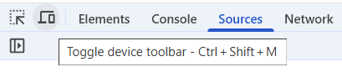
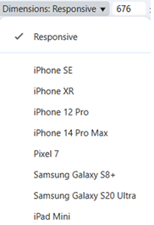
Test your design using Mobile Emulator
Open Dev tools e.g. in Chrome (F12 or Ctrl-Shift + I)
Toggle Device Toolbar
Test different devices.

Slide 8
Semantic controls
Tags like <div> , <p> , <span> don't reveal their content type or purpose
Tags like <form>, <table>, <article> define their content by name
<header> Subject matter
<nav> for navigation
<article> The main article
<side> side tag for extra info/ads
<footer>
Other semantic elements:
<details> <figcaption> <figure>
<main> <section> <time>
<mark> <summary>
<header>
<nav>
<section>
<aside>
<article>
<footer>

Slide 9
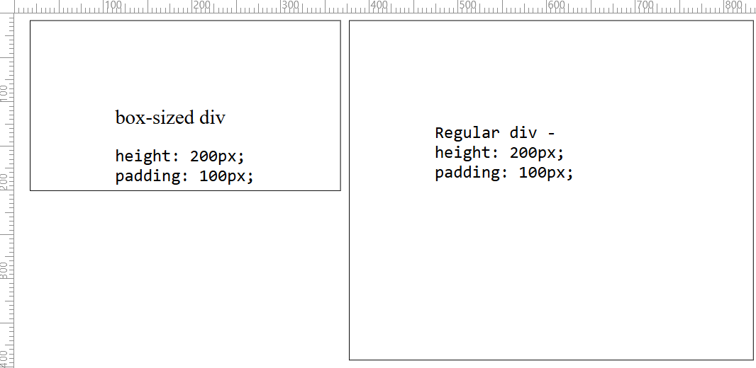
CSS Box Model
Elements have: Content → Padding → Border → Margin
Total size = Content + Padding + Border + Margin
box-sizing: border-box;
200px Height is maintained
200px added for padding (top & bottom)
Makes width and height include padding and border
view

Slide 10
15-miute activity: Box-Sizing Fix
Create a new HTML page
Place two DIVs side-by-side (float: left;)
Show borders (border: 1px solid black;)
Give both a large padding (padding: 30px;)
Set the height of both DIVs to say 100px
Put some text into each DIV
Give the first DIV the attribute: box-sizing: border-box;
Display your page and observe the difference between the two DIVs
Experiment by creating your own page if time permits

Slide 11
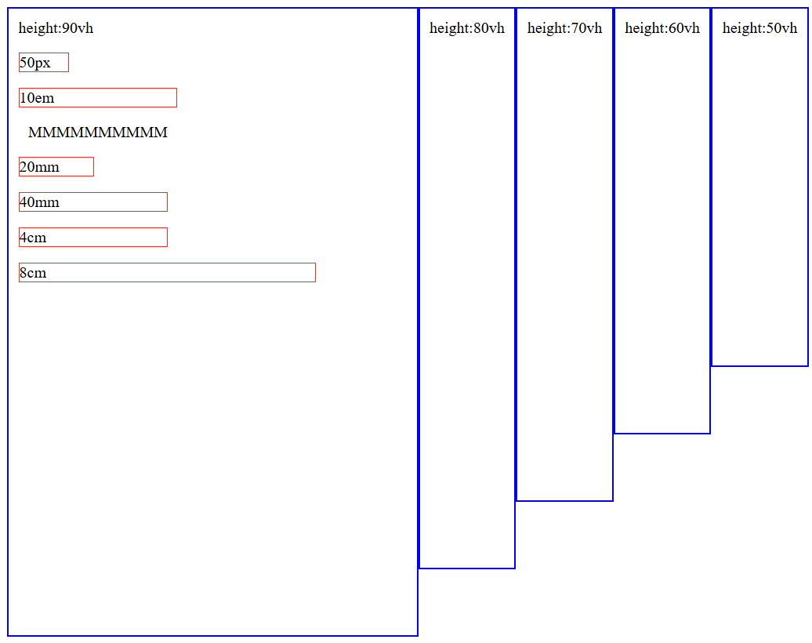
Fluid Units - Absolute vs Relative
Absolute: px, cm
Relative: %, vw, vh, em
Use relative units for responsiveness.
<div class="container" style="height:90vh;width: 30%">
height:90vh
<p style="width:50px">50px</p>
<p style="width:10em">10em</p>
<span>MMMMMMMMMM</span>
<p style="width:20mm">20mm</p>
<p style="width:40mm">40mm</p>
<p style="width:4cm">4cm</p>
<p style="width:8cm">8cm</p>
</div>
<div style="height:80vh">height:80vh</div>
<div style="height:70vh">height:70vh</div>
<div style="height:60vh">height:60vh</div>
<div style="height:50vh">height:50vh</div>
View

Slide 12
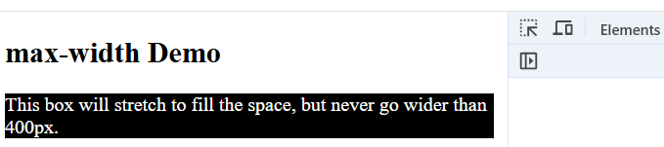
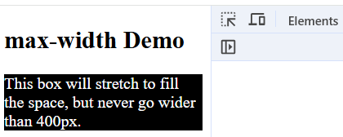
max-width vs width
width: fixed size
max-width: sets a max size but allows shrinking
Recommended: max-width + %
.box {
max-width: 400px;
width: 100%;
}
<div class="box">
This box will stretch to fill the space, but never go wider than 400px.
</div>
400px
Does shrink!
View

Slide 13
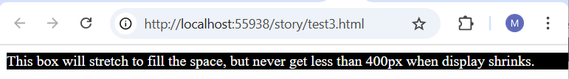
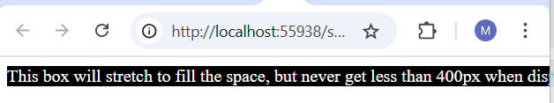
min-width
min-width: sets a min size but does NOT allow shrinking
.box {
min-width: 400px;
}
<div class="box">
This box will stretch to fill the space, but never get less than 400px when display shrinks.
</div>
Does not shrink!
View

Slide 14
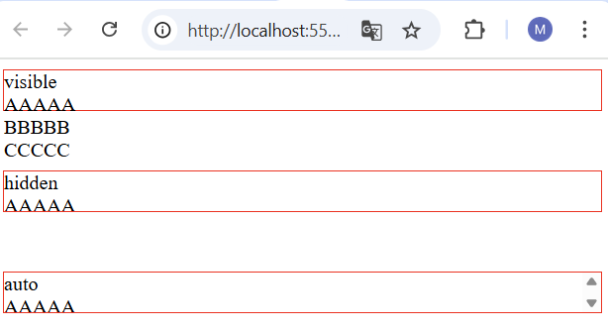
Overflow Control
visible: default
hidden: clips content
scroll: adds scrollbars
auto: adds scrollbars if needed
All divs contain: AAAAA BBBBB
CCCCC
#box1 {
overflow: visible;
}
#box2 {
overflow: hidden;
}
#box3 {
overflow: auto;
}
View

Slide 15
15-minute activity: Overflow Handling
Objective: Fix an overflowing image inside a container
Create an HTML page with the following content and style
To fix the problem, add the following to image's style
Experiment by creating your own page if time permits
<div class="container">
<img src="https://www.qa.com/media/upsnyqs4/wb3-1079587192.jpg?width=900" alt="students image">
</div>
<style>
.container {
width: 300px;
height: auto;
border: 5px solid red;
overflow: visible; /* or hidden */
}
img {
width: 800px;
height: auto;
}
</style>
Run and observe the problem
max-width: 100%;
view

Slide 16
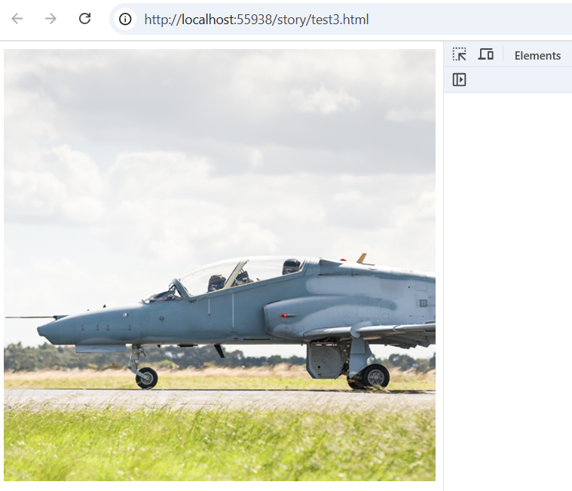
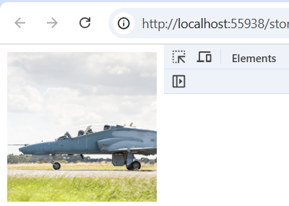
Responsive Images
Ensures images scale with their container.
img {
max-width: 100%;
height: auto;
}

Slide 17
Lazy-loading images
delays loading images until they are needed for performance
typically, when they are about to enter the user's viewport
For new browsers 2019,20+
Use code for older browse (view the next slide)
<img src="team.jpg" loading="lazy" alt="picture of our team" >

Slide 18
Lazy-loading images for older browsers
<img src="team.jpg" class="lazy" alt="picture of our team">
document.addEventListener("DOMContentLoaded", () => {
const lazyImages = document.querySelectorAll(".lazy");
// detect when an element enters or leaves the viewport
const observer = new IntersectionObserver((entries, obs) => {
entries.forEach(entry => {
if (entry.isIntersecting) {
const img = entry.target;
img.src = img.dataset.src;
img.classList.remove("lazy");// stop loading again
obs.unobserve(img);
}
});
});
lazyImages.forEach(img => observer.observe(img));
});

Slide 19
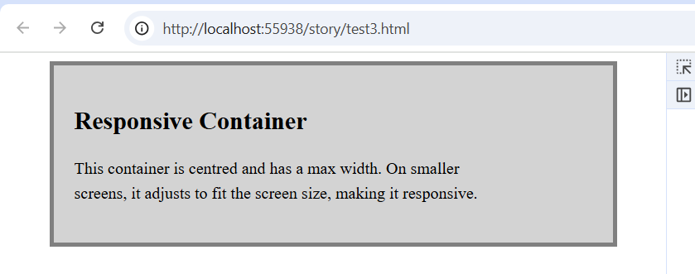
Responsive Containers
Use container classes with % or vw widths
Combine with padding/margin for spacing
.container {
max-width: 500px;
margin: 0 auto; /* centre contents*/
padding: 20px;
background-color: lightgrey;
border: 4px solid grey;
}
p {
width: 25rem;
line-height: 1.5; /* 1.5 times container font size*/
}
<div class="container">
<h2>Responsive Container</h2>
<p>This container is centred and has a max width. On smaller screens, it adjusts to fit the screen size, making it responsive.</p>
</div>

Slide 20
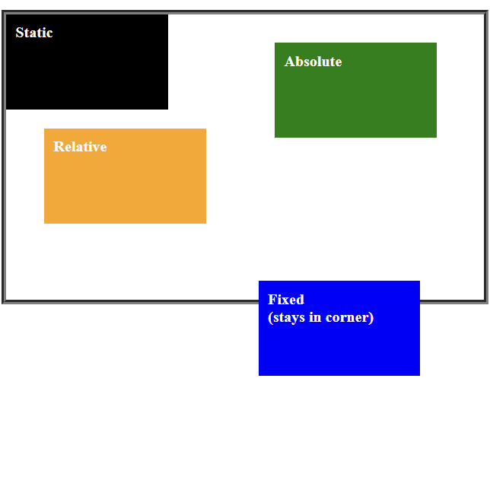
CSS - positioning elements
position default, static, absolute, sticky …
30
.container {
position: relative;
height: 300px;
border: 5px groove gray;
}
.static {
position: static;
background-color: black;
}
.relative {
position: relative;
left: 40px;
top: 20px;
background-color: orange;
}
.absolute {
position: absolute;
right: 50px;
top: 30px;
background-color: green;
}
20
50
40
container
80
page
200
.fixed {
position: fixed;
bottom: 200px;
right: 80px;
background-color: blue;
}
View

Slide 21
The Viewport
The viewport is the visible area of a web page on a device.
Affects how CSS media queries are interpreted.
Use Viewport Meta tag
Ensures the layout scales properly on different devices
Avoid setting fixed width/height in pixels
Test your layout for different devices
<html> <head>
<meta name="viewport" content="width=device-width, initial-scale=1.0">

Slide 22
What are Media Queries?
Apply CSS rules based on device characteristics
like screen width, height, resolution, etc.
<head>
<meta name="viewport" content="width=device-width, initial-scale=1.0">
<style>
@media (max-width: 768px) {
body {
background: cyan;
}
</style>

Slide 23
Common Breakpoints
320px small phones
480px phones
768px tablets
1024px small laptops
1200px+ desktops
<style>
@media (max-width: 480px) {
body {
background: cyan;
}
@media (max-width: 768px) {
body {
background: grey;
}
</style>
Group breakpoints logically
view

Slide 24
Lab
Convert a fixed-width layout into a responsive one using media queries, flex, and grid.

Slide 25
Summary
In this session, you learned about the following key concepts:
viewport,
media queries,
box model

